Slide 1

Detecting aberrant expression in RNA-seq
A Hands-on Tutorial through Bioinformatics Tools and Workflows
Vicente A. Yépez
Ines Scheller
Nicholas Smith
Holger Prokisch
Julien Gagneur
Technical University of Munich

Slide 2

350 millions persons worldwide are affected by rare diseases

Slide 3
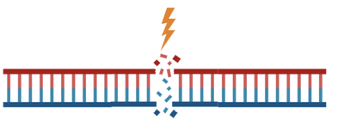
Rare diseases are predominantly caused by mutations in a single gene
Current approaches aim at sequencing DNA to find the mutation(s)

Slide 4
The current diagnosis rate is ~50%

Slide 5
To improve the diagnosis rate, complementary approaches to DNA-seq need to be used

Slide 6
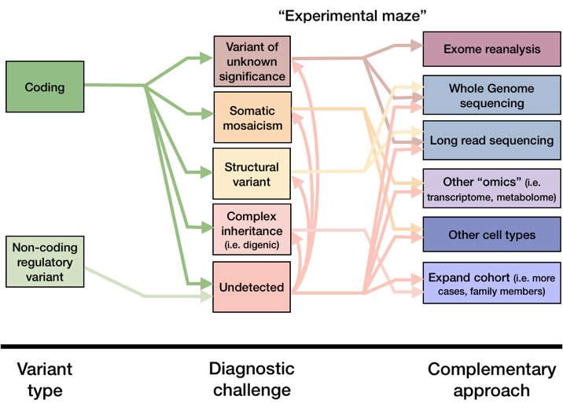
For “exome-negative” cases, choosing the next step in an experimental maze is a major challenge
Fresard and Montgomery, Cold Spring Harb Mol Case Stud, 2018

Slide 7
Here we focus on how RNA-sequencing can help the identification of causal genes
Fresard and Montgomery, Cold Spring Harb Mol Case Stud, 2018

Slide 8
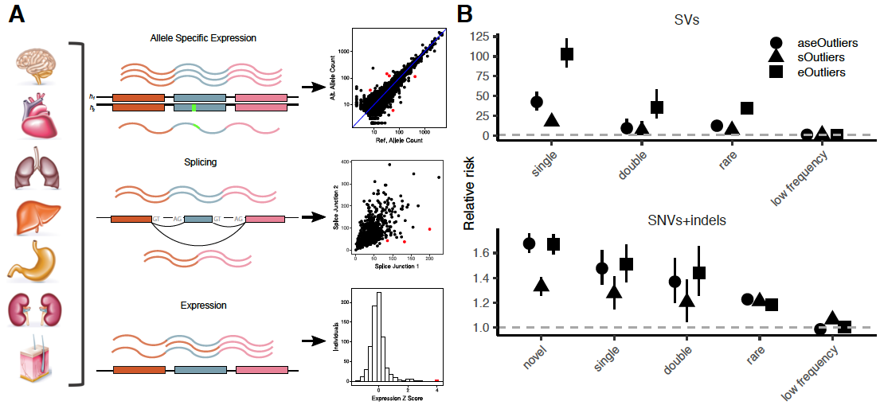
Expression/splicing outliers and allele-specific expression can pinpoint rare variants with large effects
Allele specific expression
Splicing
Expression
Ferraro, Strober et al, biorxiv 2019
Li, Kim, Tsang, Davis, et al, Nature 2017

Slide 9
Expression/splicing outliers and allele-specific expression can pinpoint rare variants with large effects
Ferraro, Strober et al, biorxiv 2019
Li, Kim, Tsang, Davis, et al, Nature 2017

Slide 10
RNA-seq has shown diagnostic utility in multiple instances

Slide 11
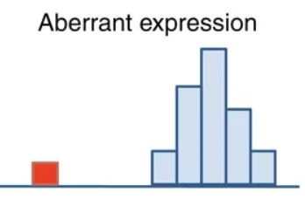
Gene expression information can identify impaired genes

Slide 12
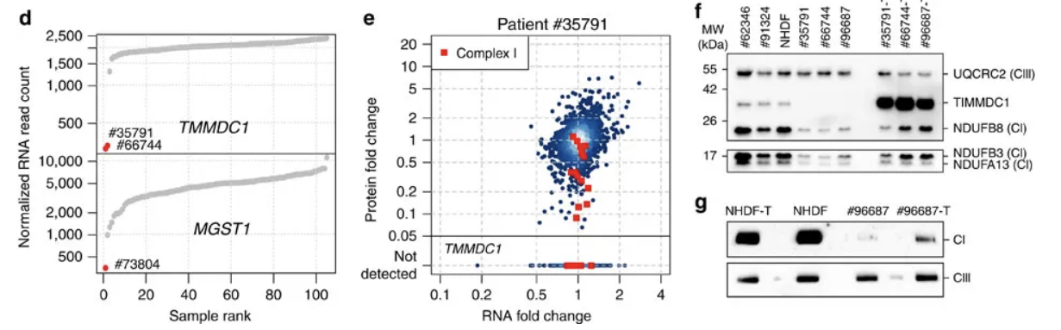
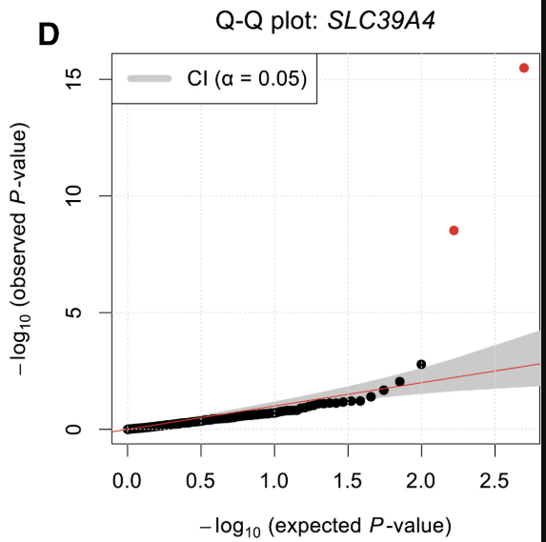
Detection of expression outliers
Kremer et al Nature Communications 2017
Brechtmann et al AJHG 2018

Slide 13
Splicing defects are involved in numerous genetic diseases

Slide 14
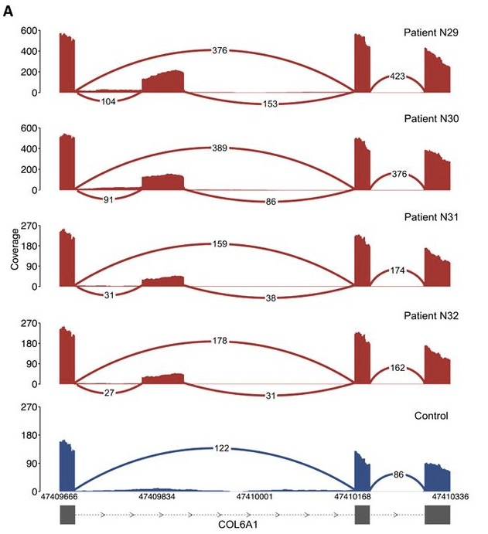
Exon creation
Patients
Control
Gene model
Cummings et al Science Translational Medicine 2017

Slide 15
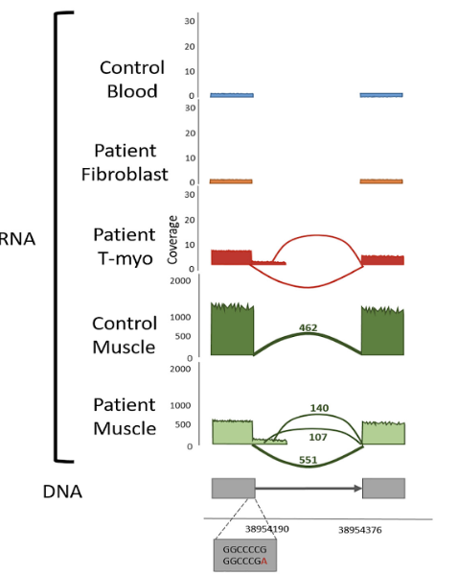
Exon elongation
Gonorazky et al AJHG 2019

Slide 16
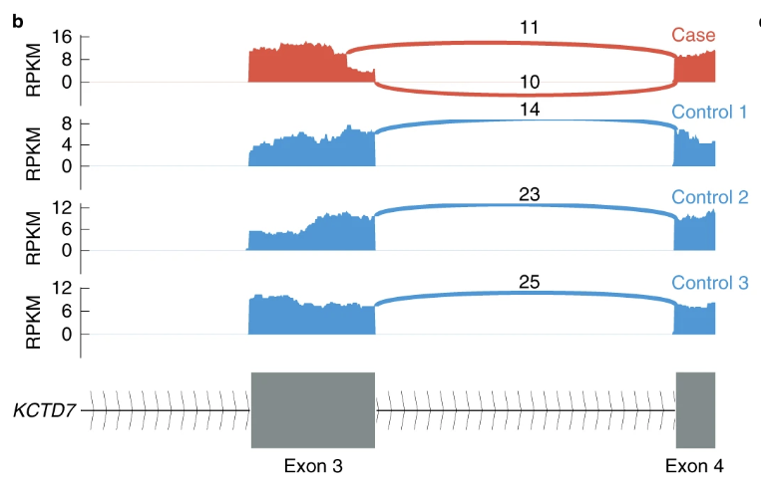
Exon truncation
Fresard et al Nature Medicine 2019

Slide 17
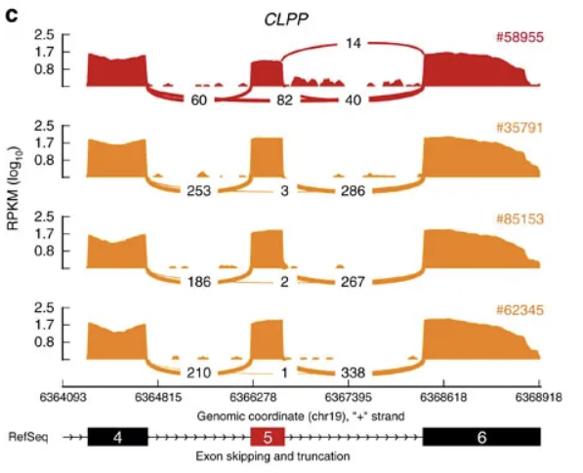
Exon skipping
Kremer et al Nature Communication 2017

Slide 18
Mono-allelic expression highlights variants of interest
ALT vs REF ratio

Slide 19
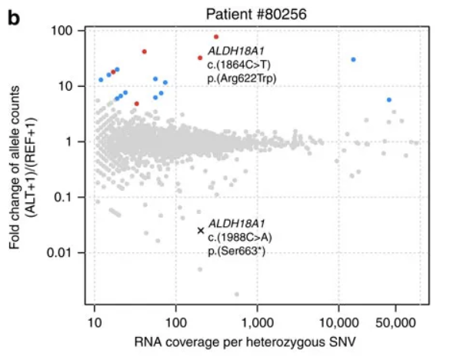
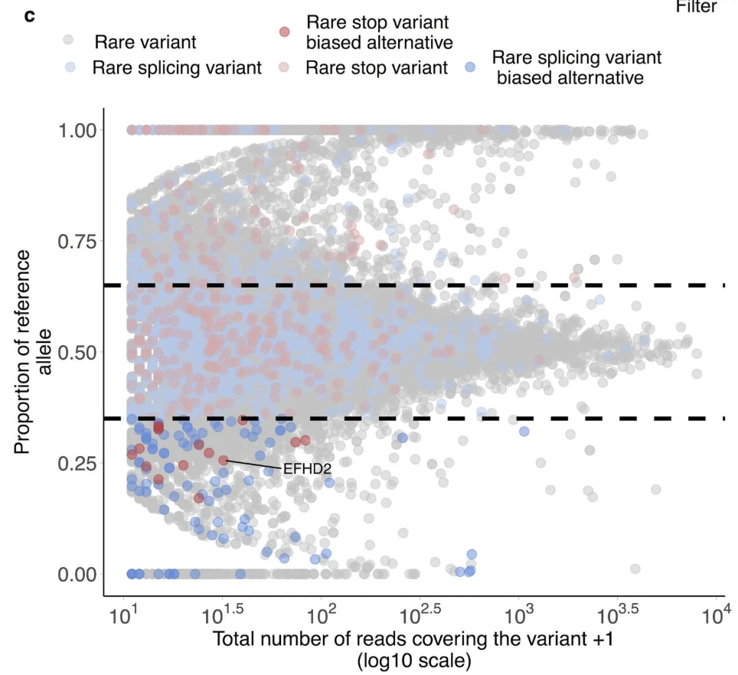
Detection of rare variants with mono-allelic expression
Rare variants with MAE
Imbalanced rare deleterious alleles
significant
significant + rare variant
Kremer et al Nature Communication 2017
Fresard et al Nature Medicine 2019

Slide 20
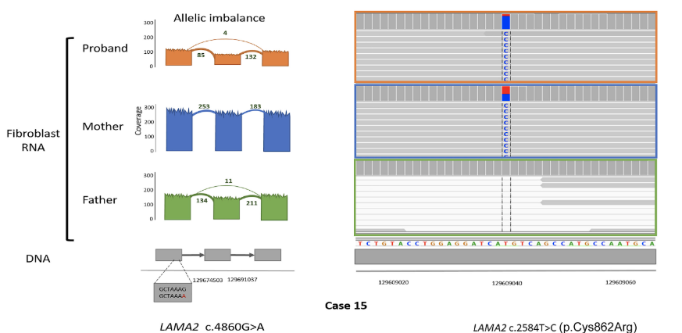
Validation of suspected events such as exon skipping
Gonorazky et al AJHG 2019

Slide 21
Calling variants in RNA-seq data allows to capture regions missed by WES

Slide 22
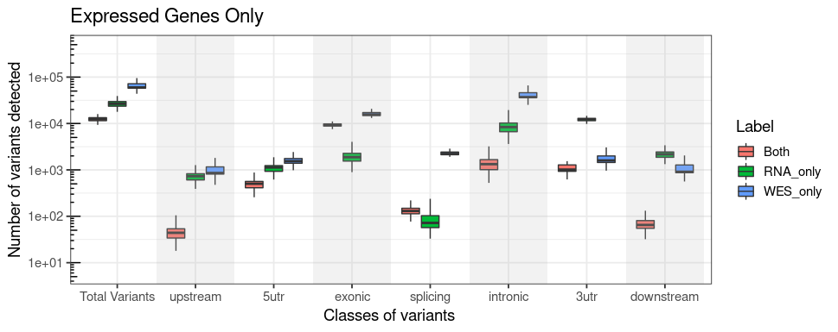
RNA-Seq covers regions missed by WES

Slide 23
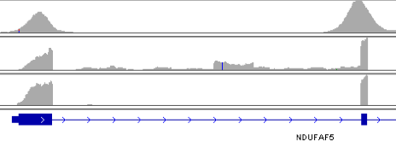
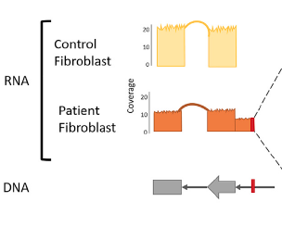
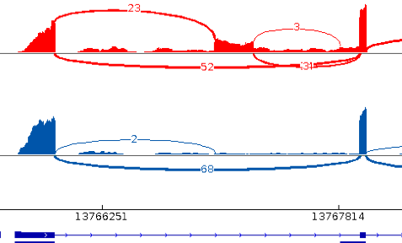
Examples of intronic and 5’UTR variants missed by WES
Intronic
5’UTR
WES sample
RNA sample
RNA control
RNA sample
RNA control
Gonorazky et al AJHG 2019

Slide 24
Recent work has allowed studying multiple challenging aspects of RNA-Seq usage in rare diseases
Notes:
7.7-30% diagnosis rate

Slide 25


Challenges when using RNA-Seq
Datasets are noisy
Not all variants affect expression
Genes are expressed in a tissue/time specific manner
The disease tissue is not always accessible
Surrogate tissues are an alternative but causal genes might not be expressed
Transdifferentiate cells to reflect affected tissue
Gonorazky et al AJHG 2019

Slide 26
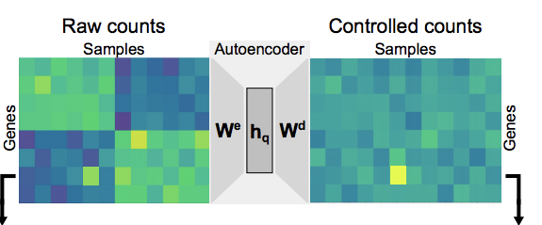
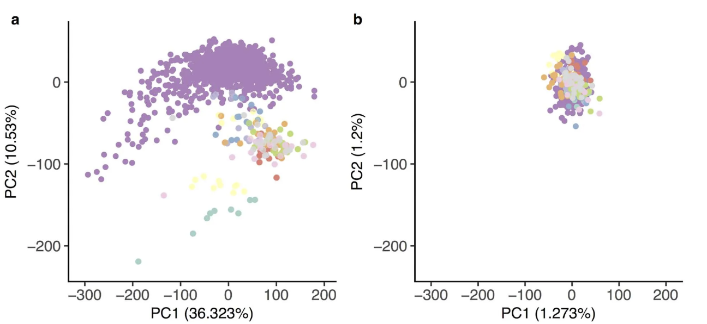
Correcting for sample co-variations is necessary
Many variables are affecting gene expression; some of them are biological, such as sex, age, general health...
Other sources of noise are technical, such as sequencing batch, library size, technician, room temperature, RNA quality...
Autoencoder
Surrogate Variable Analysis
Brechtmann et al AJHG 2018
Fresard et al Nature Medicine 2019

Slide 27


Adding transcriptome of control individuals helps obtaining more robust results
1. From the same disease batch
Other cases can serve as controls.
2. Using external data (GTEx, i2QTL, BIOS, DROP)
Allows to add more information but also more noise

Slide 28
What you will learn today
find expression outliers, splicing outliers and mono-allelic expression
reevaluate and prioritize candidate genes
visualize complex and high dimensional raw data and results derived from RNA-seq data

Slide 29
Dataset used in the workshop
100 RNA-seq samples from the Geuvadis project
Matching WES data from the 1000 genome project
Outliers are injected from various publications
Lappalainen et al., Nature, 2013
1000 Genomes Project Consortium, Nature, 2012

Slide 30
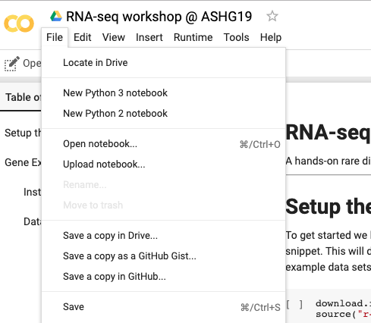
Let’s get started!
Open the following link to the notebook:
tinyurl.com/RNA-eMed-colab
Then make a copy by clicking:
File > Save a copy in Drive

Slide 31
Gene Expression Outlier Detection

Slide 32
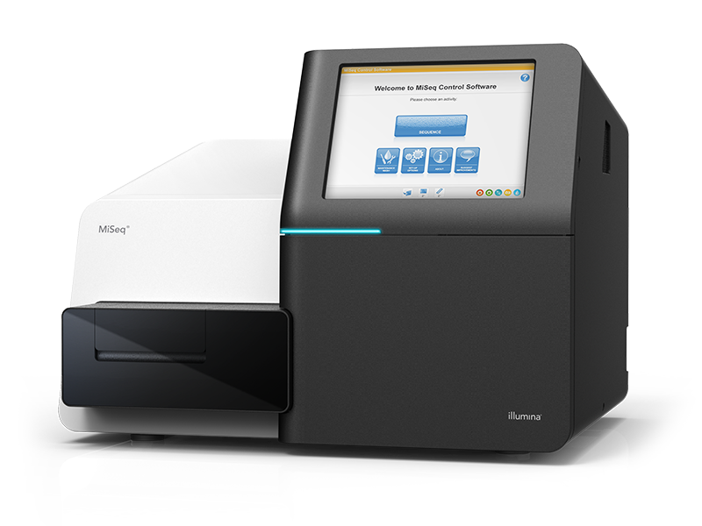
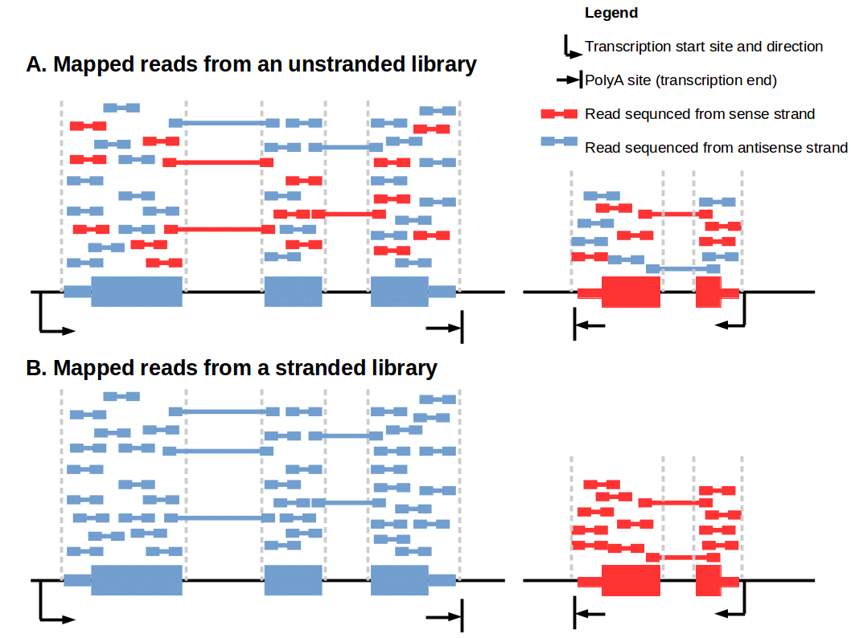
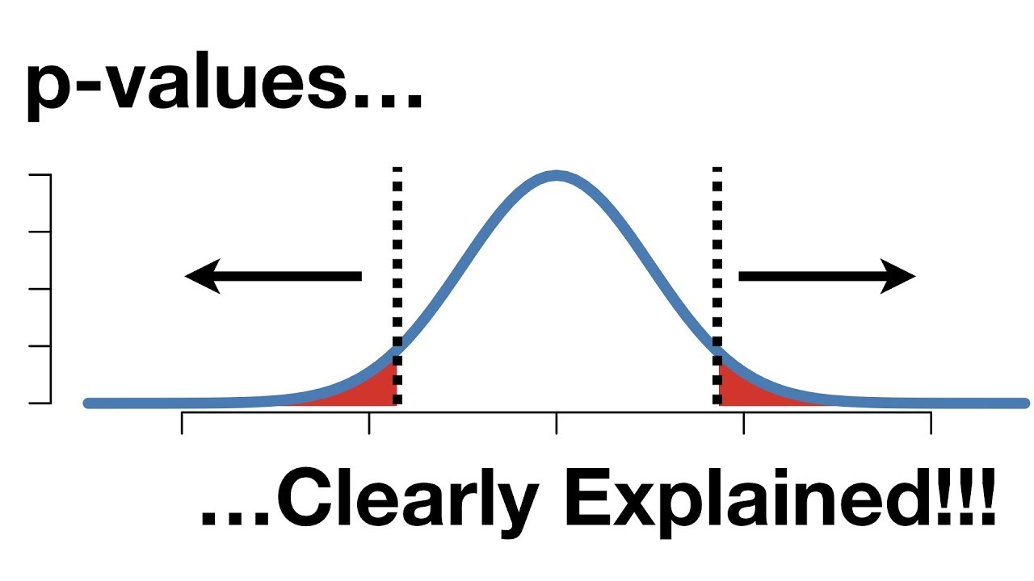

From RNA-seq data to expression outliers
RNA-seq
Counting
QC
Filtering
Modeling
Detection

Slide 33
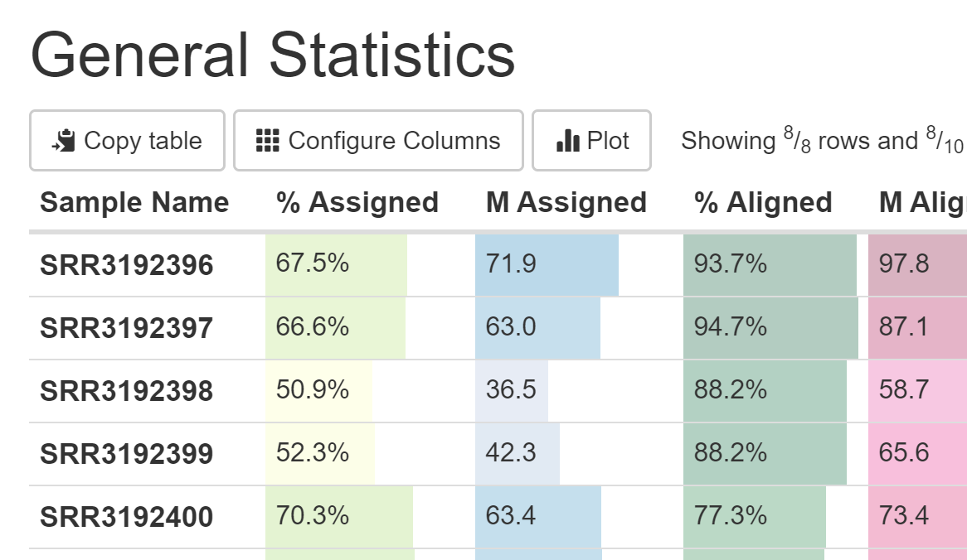
Important steps before modeling
RNA-seq
Counting
QC Filtering
Modeling
Detection
Read counting parameters affect the modeling and are crucial:
Genome assembly
RNA-seq aligner
Gene annotation
Handling duplicated/multi-mapped reads
Filtering samples/genes
MultiQC output

Slide 34
Correcting for Confounders
RNA-seq
Counting
QC Filtering
Modeling
Detection
Surrogate variable Analysis
Removing sample co-variation is important!
All roads lead to Rome:
PCA
Surrogate variable analysis
Denoising autoencoders
...
Fresard et al Nature Medicine 2019

Slide 35
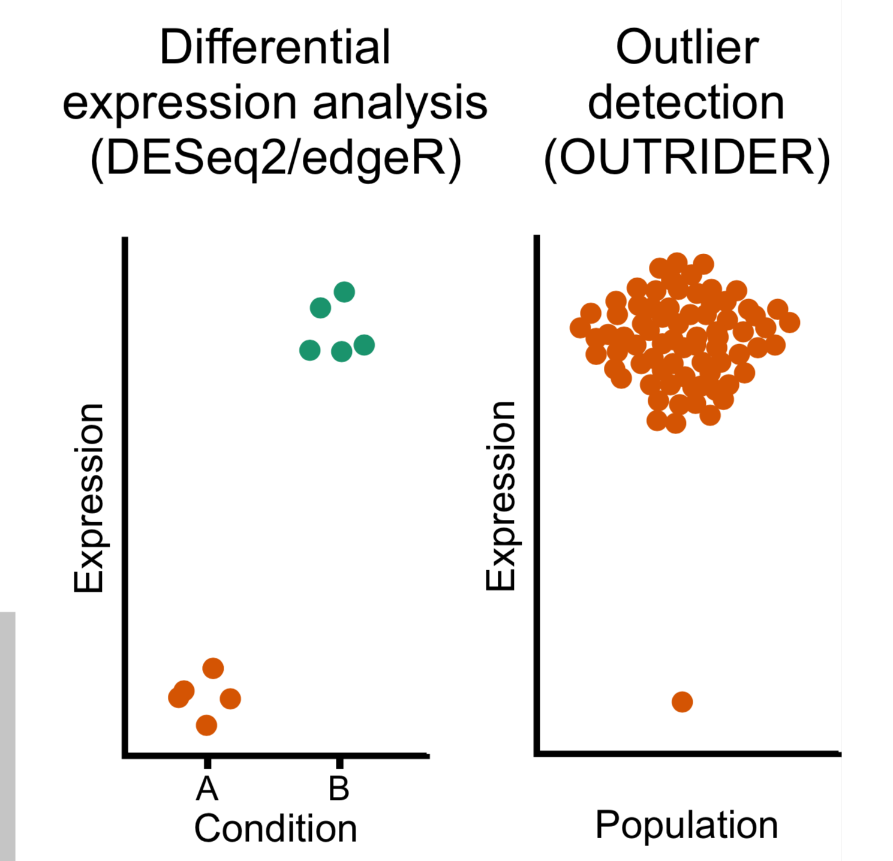
How to define outliers
RNA-seq
Counting
QC Filtering
Modeling
Detection
Differential expression analysis
Outlier detection
Outlier calling is not a differential expression analysis!
We fit 1 distribution across the population

Slide 36
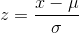
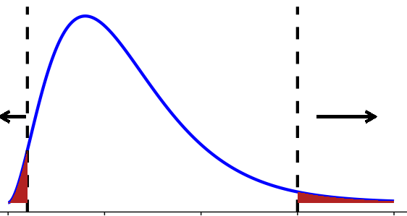
How to define outliers
RNA-seq
Counting
QC Filtering
Modeling
Detection
P value-based outlier detection:
Predefined distribution (eg: Negative Binomial)
Uses a significance-based cutoff
Z score-based outlier detection:
Assumes gaussian distribution
Uses a predefined cutoff (eg: |z|>2)
Density
Density
Z score
Raw count

Slide 37
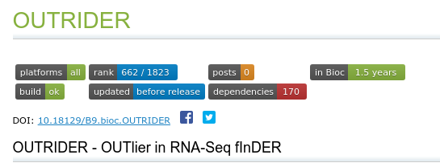
OUTRIDER: specialized method to detect aberrant expression
Controls for covariation using a denoising autoencoder
Computes p-values based on the Negative Binomial distribution
Corrects for multiple testing
Provides plotting functions to visualize results
Available in R/Bioconductor

Slide 38
Aberrant splicing detection

Slide 39
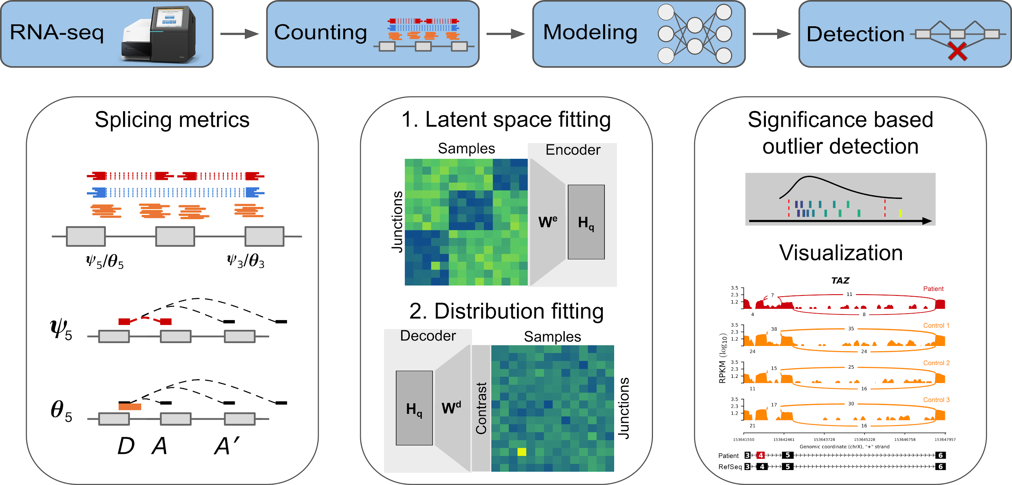
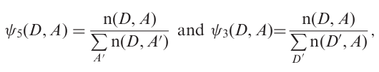
The intron-centric splicing metrics:
Percent Spliced In
All splicing metrics are defined as ratios (K/N)
K: number of split reads spanning one intron
N: all split reads leaving one donor or arriving to one acceptor
𝝍_{5/3} (Percent Spliced In) can detect alternative donor and acceptor usage
They are annotation-free which allows to capture new splice sites
The donor or 5’ specific splicing metric
Pervouchine et al, Bioinformatics, 2013

Slide 40
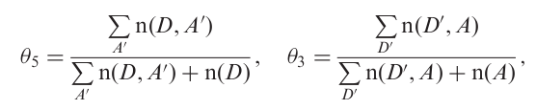
The intron-centric splicing metrics:
Splicing Efficiency 𝜃
𝜃_{5/3} takes into account non-split reads spanning exon-intron boundaries
𝜃_{5/3} can detect intron retention or exon elongation and truncation
The donor or 5’ specific splicing metric
Pervouchine et al, Bioinformatics, 2013

Slide 41
FRASER: context-dependent splicing outlier detection
Mertes, Scheller et al, bioRxiv, 2019

Slide 42
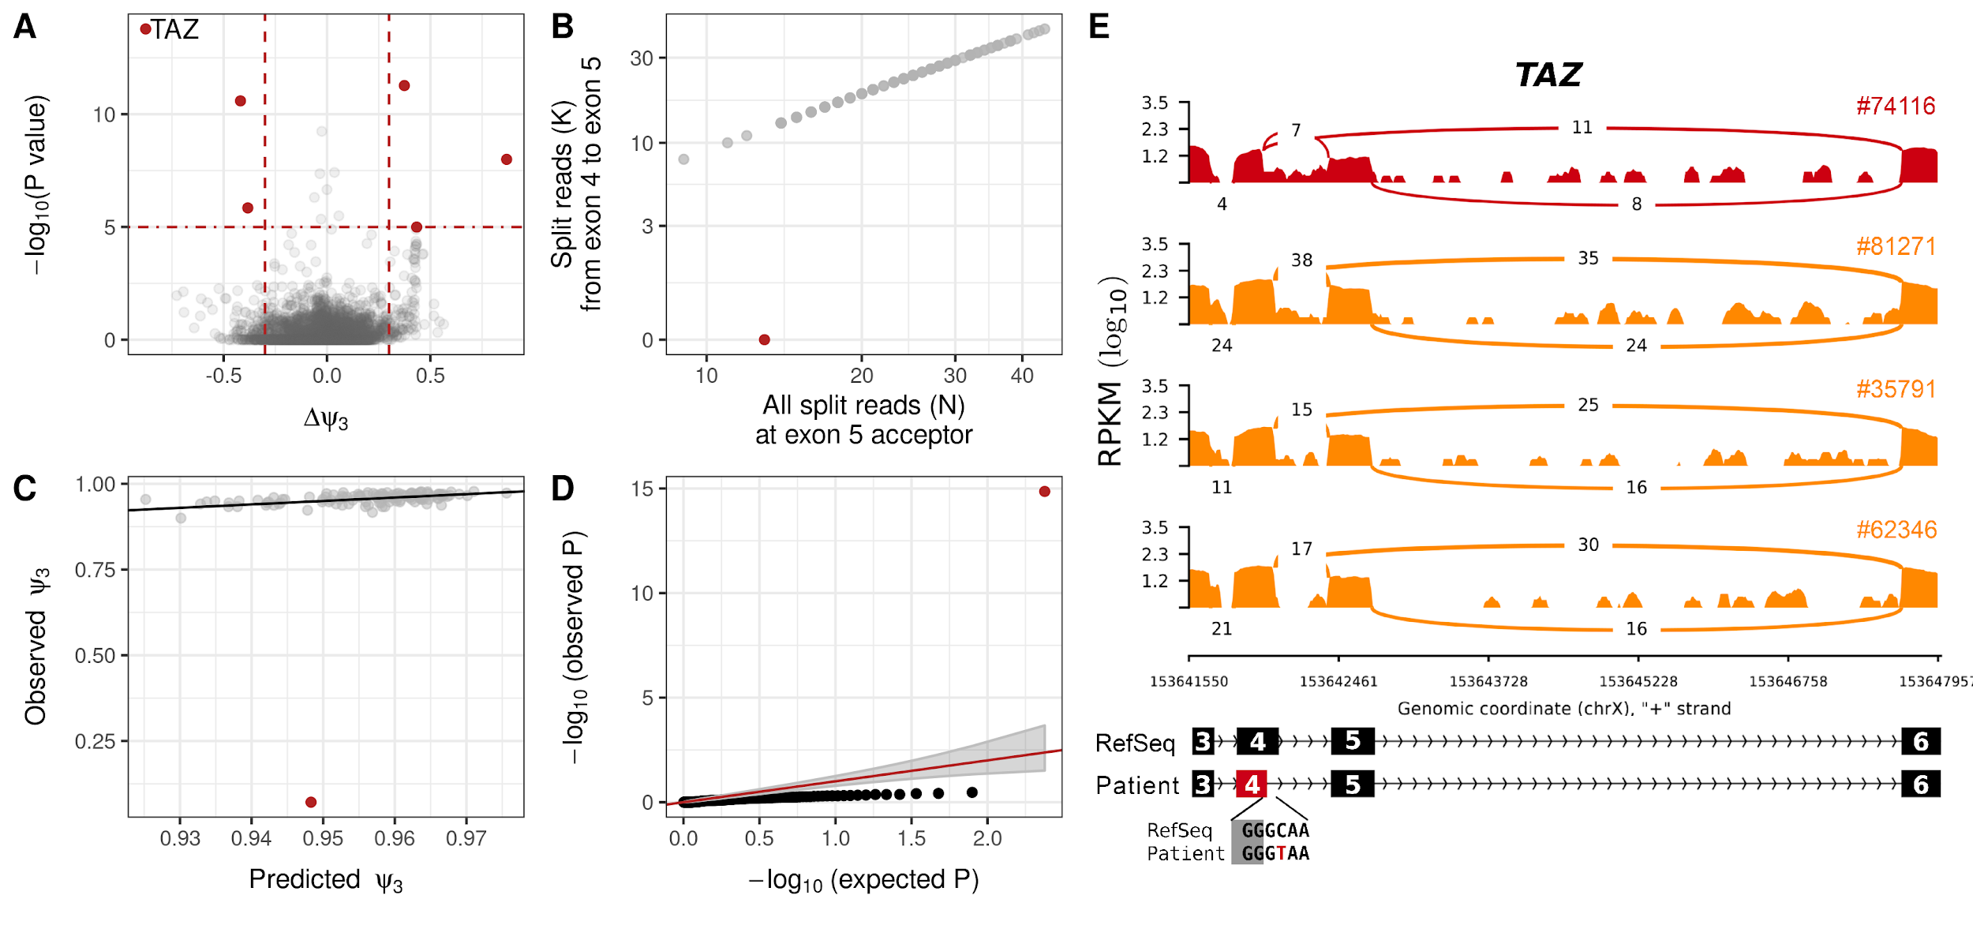
Interpreting results
Mertes, Scheller et al, bioRxiv, 2019
Patient 74116 has an early splicing donor in exon 4 (exon truncation)
The control samples have normal splicing between exons 4 and 5 (k vs N plot)
𝚫𝜓₃ = observed 𝜓₃ - predicted 𝜓₃
𝚫𝜓₃ close to 0 for all samples, except for the patient
RPKM

Slide 43
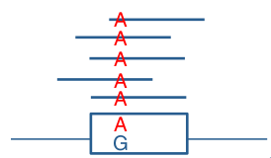
Detection of mono-allelic expression

Slide 44
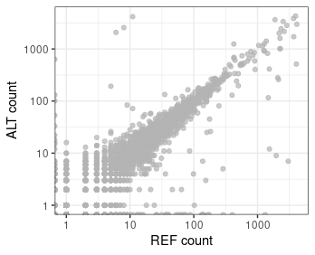
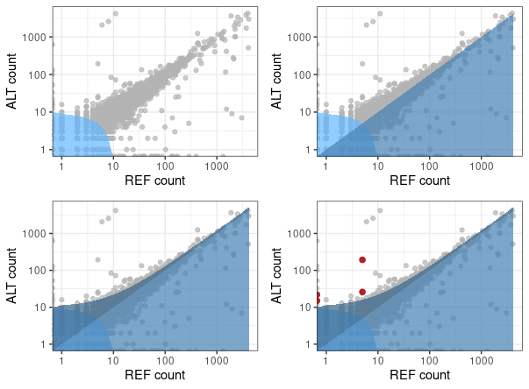
From allelic counts to rare mono-allelically expressed variants
DNA-seq
QC
Counting
Testing
RNA-seq

Slide 45
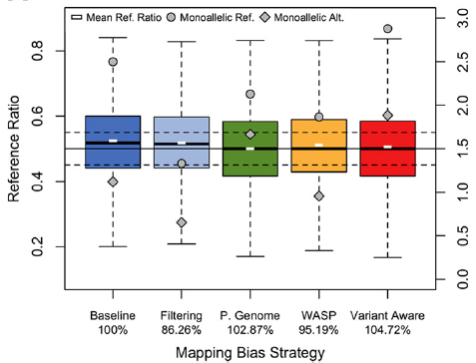
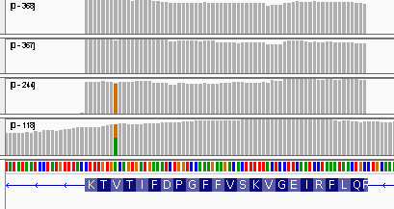
Considerations before testing for MAE
QC
Mind mapping bias towards reference allele
should not matter in our case as we are looking for high changes of the alternative allele
can be corrected using e.g. WASP
Distinguish between MAE and genotyping error
Visualize your raw data
Look for other variants in the gene → they must also be mono-allelically expressed
RNA
DNA
[0-244]
REF
ALT
[0-118]
Castel et al Genome Biology 2015
WASP: van de Geijn et al Nature Methods 2016
Notes:
Filtering = aligned with bias and mappability filters, P. Genome = aligned to a personalized genome, WASP = aligned with removal of biased reads using WASP, Variant Aware = GSNAP in variant aware alignment mode

Slide 46
How to obtain allelic counts
Counting
Call variants on either WES or WGS
Subset for heterozygous SNVs only
Homozygous variants do not provide allele-specific information
Count RNA reads assigned to each allele
ASEReadCounter from GATK
Discard:
low quality reads and variants
duplicated reads
T
T
T
T
Castel et al Genome Biology 2015

Slide 47
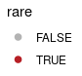
Test for mono-allelic expression
Testing
Steps
1. Remove low expression
2. Focus on alternative
3. Significance test done per sample → no need to remove sample co-variation
4. Prioritize rare variants (does not necessarily mean those are the causal ones!)

Slide 48
Calling variants from RNA-Seq data

Slide 49
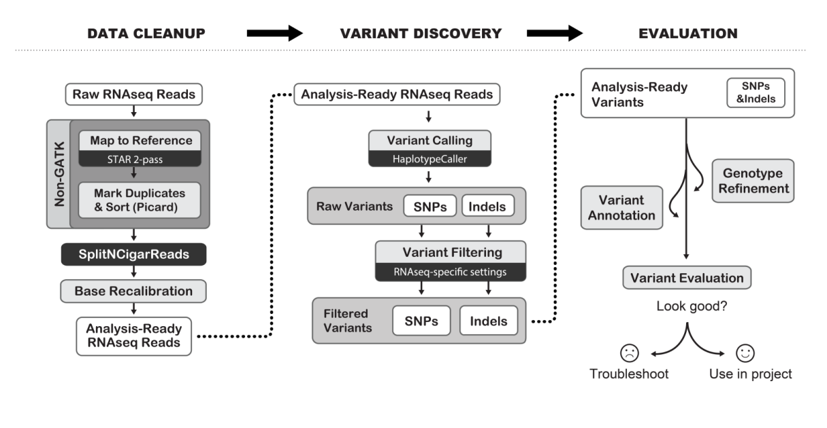

RNA-Seq Variant Calling Pipeline
Add external annotations and prioritize
GATK 3.8 pipeline.
GATK RNAseq short variant discovery

Slide 50
Calling and Annotating RNA-seq Variants
Read cleanup and processing
bam files
Sample 1
Sample 2
Sample 3
Variant calling in batches
bam files
Sample 1
Sample 2
Sample 3
FRASER
OUTRIDER
vcf files
Multi sample vcf
VCF quality checks
vcf files
WES
Sample 1
Sample 2
Sample 3
External Annotation: VEP, OMIM, gnomAD,
MMSplice, SpliceAI,
Framepool
Consolidated Table
Notes:
Process:
GATK https://gatk.broadinstitute.org/hc/en-us/articles/360035531192-RNAseq-short-variant-discovery-SNPs-Indels-
Mark duplicates: identify reads originating from the same RNA fragment
Split Cigar Reads: for all reads that have a gap in their matching, split them into contiguous reads without gaps. 25M100N50M → 25M, 50M
Base re-calibration: uses the a model covariation of the reported quality scores and known variants to recalibrate the reported scores of mutations
Single source Variant calling: use a local realignment to identify which variants are present and their likelihood.
Combination and group variant calling: taking the individual results of variant calls as a group. Reevaluate the variant calls accounting for the calls and reads of all samples in the batch. Note Batch sizes can and will affect the variant calls!
Variant Filtration: mark variants that have 3 or more variants within 35 bases. And FS (fisher strand) > 30 indicating strand bias
Splitting: split each group variant call into the individual vcf file per patient. Taking note to left normalize vcf calls

Slide 51
External Annotation
Variant Effect
VEP: gene annotation, variant annotation
Databases
OMIM: disease related genes, inheritability method
gnomAD: maximum allele frequency
Splicing Prediction
MMSplice & SpliceAI:
Prediction of splicing events from the RNA-seq variants
Translational Effects
Framepool:
Prediction of ribosomal load from variants in the 5’ UTR
Cheng et al Genome Biology 2019
Jaganathan et al, Cell 2019 http://kipoi.org/models/Framepool/

Slide 52
Follow-up filters
These filters can help narrowing down the searchable space. Prioritize variants that are:
rare ( < 0.5 % of the population)
in genes related to disease (Mitochondrial or other disease)
not identified by WES (when available)
homozygous or potentially compound heterozygous
coding, or supported by an external effect predictor
not in repeat regions of the genome (Repeat Masker)
Richards et al ACMG Standards and Guidelines, Genetics in Medicine 2015

Slide 53
Conclusions

Slide 54
What next?
Integrate candidate genes with other sources of evidence, e.g.
Variants from WES/WGS
Phenotypes (e.g. encoded as HPO terms)
Proteomics and other omics
Experimental validation
Literature research

Slide 55
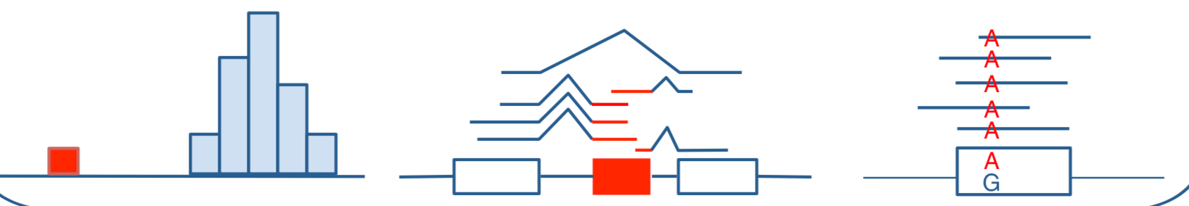
RNA-seq helps assessing the (un)predictable effect of variants
exonic variant → activating splice site
splice region variant → aberrant splicing
variants in UTR→ aberrant expression
intronic variant → cryptic exon
mono-allelic expression (MAE) of rare variant
near splice site variant with normal splicing
nonsense variant
no NMD and re-initiation of translation
nonsense variant not present in alternative isoform
nonsense variant without NMD but exon skipping
nonsense variant without NMD and protein with normal function
variants in enhancers and promoters → aberrant expression

Slide 56

Factors influencing the analysis
Sufficient and comparable sample size
Choice of filters
Data normalization
We are focusing on outlier detection, not differential expression
Transcript defects must be carefully assessed and further investigated

Slide 57
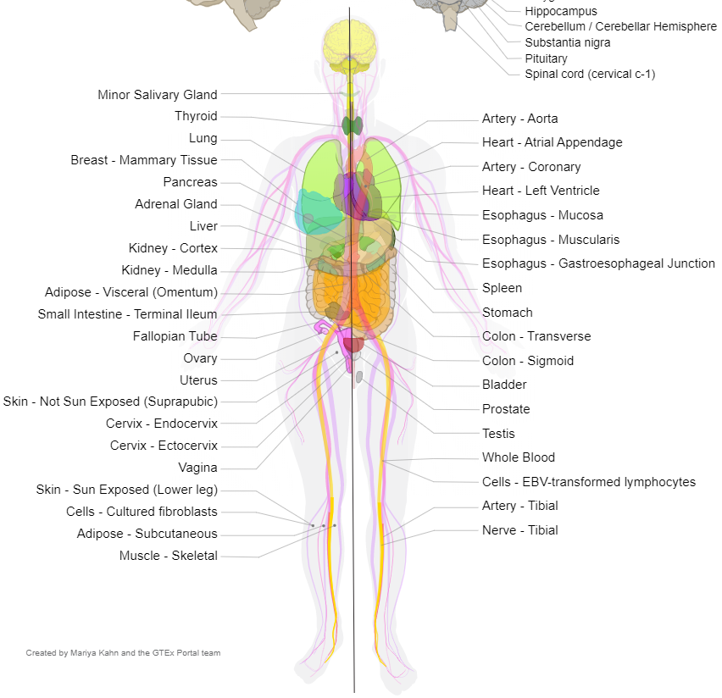
Current limitations
RNA-seq will not find the aberrant events when:
Tissue-specific expression of gene/isoform
No effect on transcript
Tissue availability
RNA-seq is only a proxy
Variant calling in RNA-seq data is highly variable due to variation in expression and post-transcriptional modifications

Slide 58
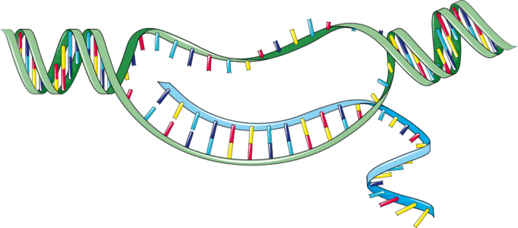
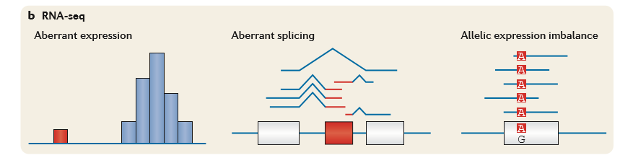
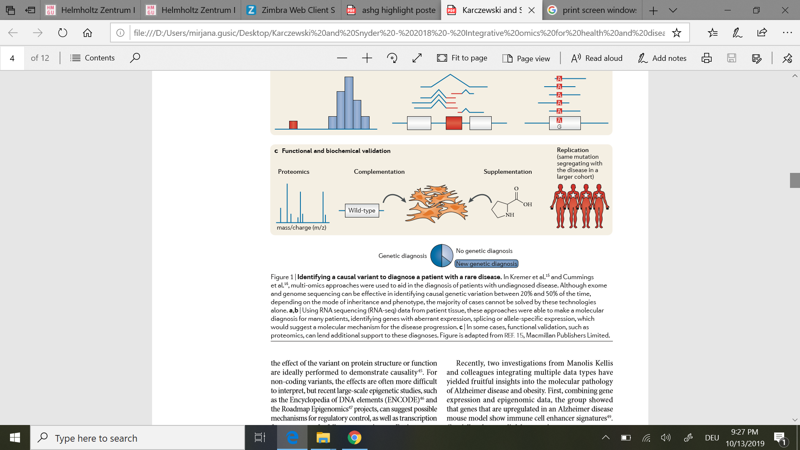
Take home messages
Outlier event must be followed by clinical interpretation to establish diagnosis
RNA-seq
Filtering
Aberrant events detection
Interpretation/ validation of (non)coding variants
Karczewski and Snyder Nat Rev Gen 2018

Slide 59
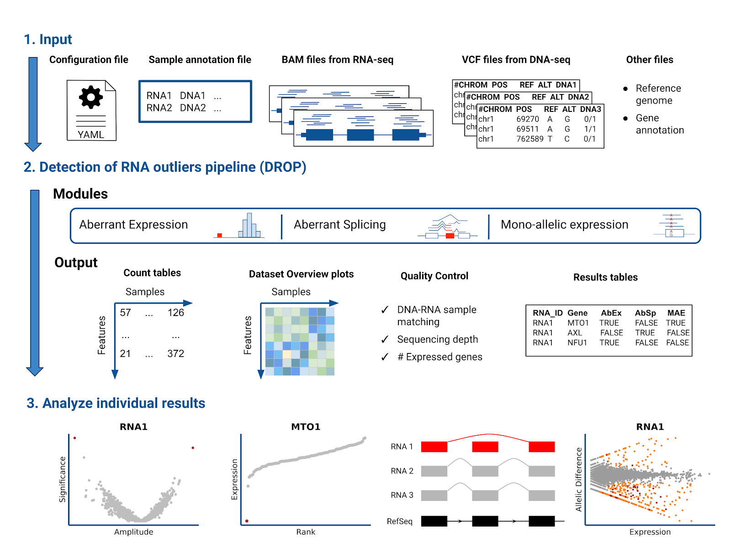

Automatized protocol includes all steps!
Yépez et al.,
Protocol Exchange, 2020
github.com/gagneurlab/drop

Slide 60



Acknowledgements
Julien Gagneur
Vicente Yépez
Ines Scheller
Nicholas Smith
Christian Mertes
Michaela Müller
Stephen Montgomery
Laure Frésard
Nicole Ferraro
Holger Prokisch
Mirjana Gusic
Robert Kopajtich
Beryl Cummings

